Slide 1


STERLING E-COMMERCE DASHBOARD
REPORT
November 7, 2023
Group 1

Slide 2

- Introduction - Meet Team AMIOD
- Project Problem Statement
- Project Objectives
- Dataset Collection and Preparation - Tools Used - Understanding the problem
- Dashboard Design and Development
- Dashboard display, Data Analysis and Insights
- Some Vital Stats
- Business Impact and Recommendations
- Future Enhancements
- Conclusion and Q&A
Agenda

Slide 3








AWARD WINNING TEAM - AMIOD
Ariyo OLUWADAMILARE Maria AKPODUADO
Onyinyechukwu NWAKANMA
Ini AKPABIO David NDUKA

Slide 4
Project Problem Statement:
Sterling E-commerce needs to optimize their porfilio and operations to improve business efficiency and meet evolving customer needs. However, they lack comorehensive insights into customer behaviours and sales patters that would inform effective strategies. By leveraging analytics on their customers behaviours, products, and order data, Sterling can uncover actionable insighte to streamline processes, adjust product assortments and provide better customer experience.
Notes:
The nightmare for every e-commerce site is to not make profit

Slide 5
Project objectives:
To identify Sterling E-commerce customers' needs, preferences, and behaviours.
To analyze patterns and trends of the dataset for customer satisfaction

Slide 6
Dataset Collection and Preparation:
The dataset was provided by Sterling E-Commerce to AMIOD.

Slide 7
Tools Used:
Microsoft Excel: was used for data cleaning, manipulation and dashboards creation.
Google Drive: for seamless collaboration, to save and share files containing Personally Identifiable Information of customers.
Whatsapp Group: for instant messaging.
Google Meet: for meetings.

Slide 8
1. Understanding the Problem
To Understand the problem, we examined the project brief to get a good grasps of the business requirements, and the following questions were investigated;
- What specific challenges or goals should be addressed?

Slide 9
Understanding the Problem (cont.)
- What kind of data is currently collected and how is it being utilized in the business strategy?
-What are the KPIs and how are their success measured?

Slide 10
2. Data Cleaning and Preprocessing:
The following steps were taken to prepare the data for analysis :
- Modified the date fields.
- Converted the abbreviated states’ names to full names.

Slide 11
3. Data Gathering:
Primary data was provided by Sterling E-Commerce for this analysis.

Slide 12
4. Data Exploration
The dataset was examined to;
- Discover relationships,
- Uncover trends and patterns.

Slide 13
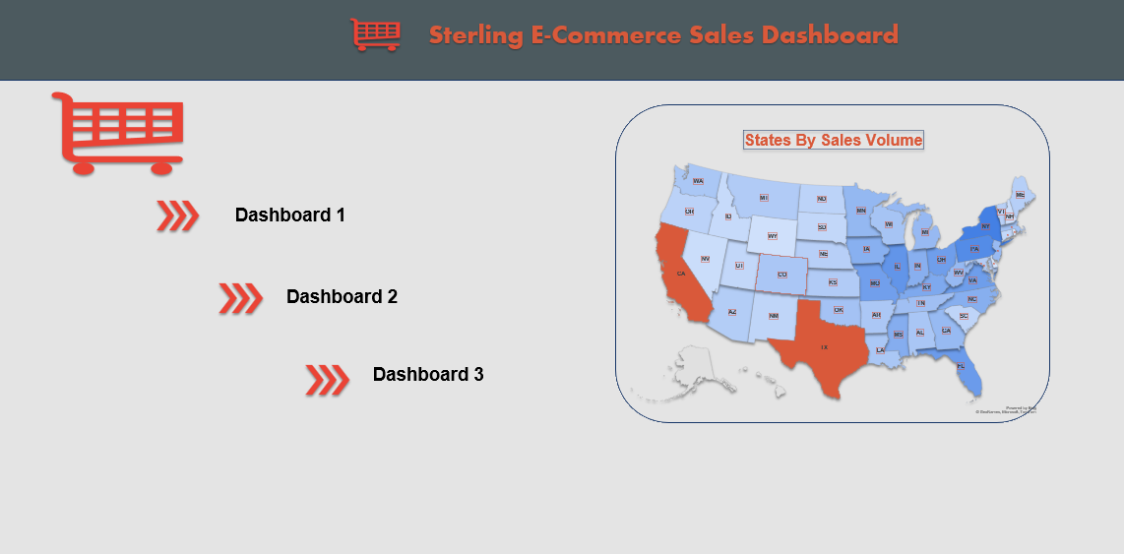
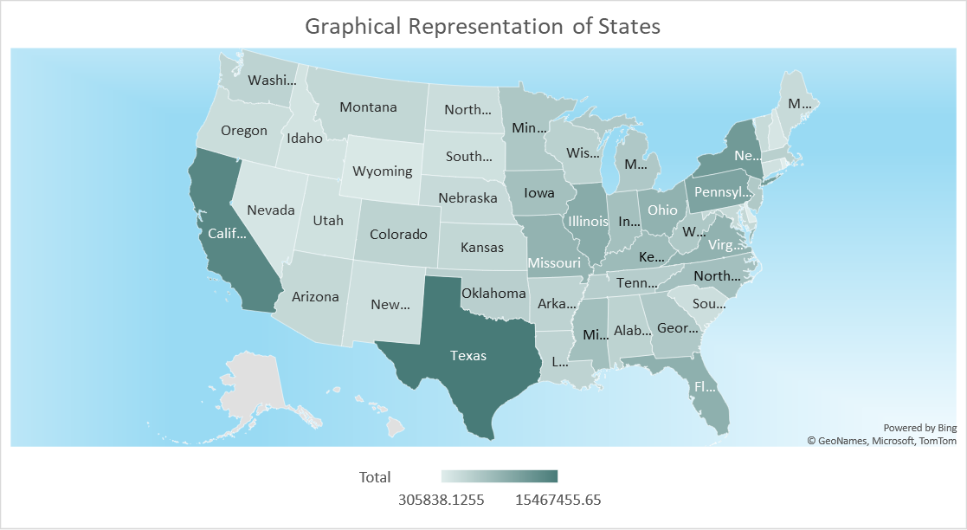

Slide 14
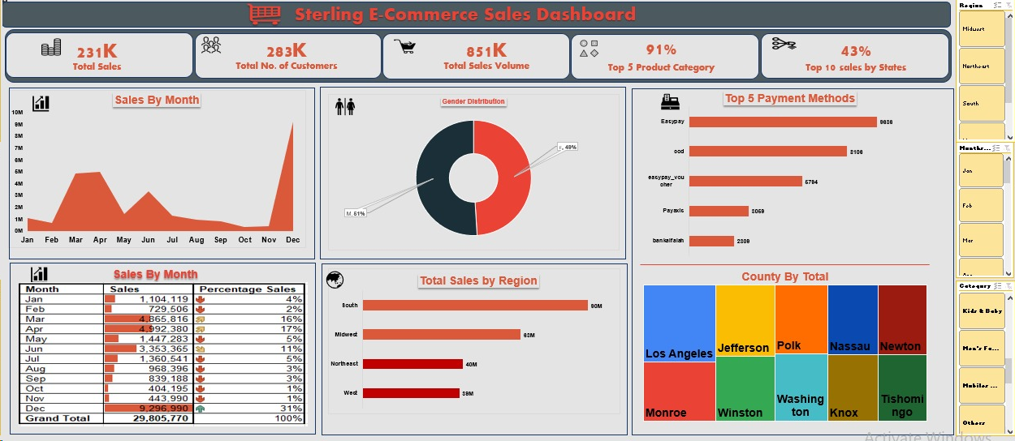

Slide 15
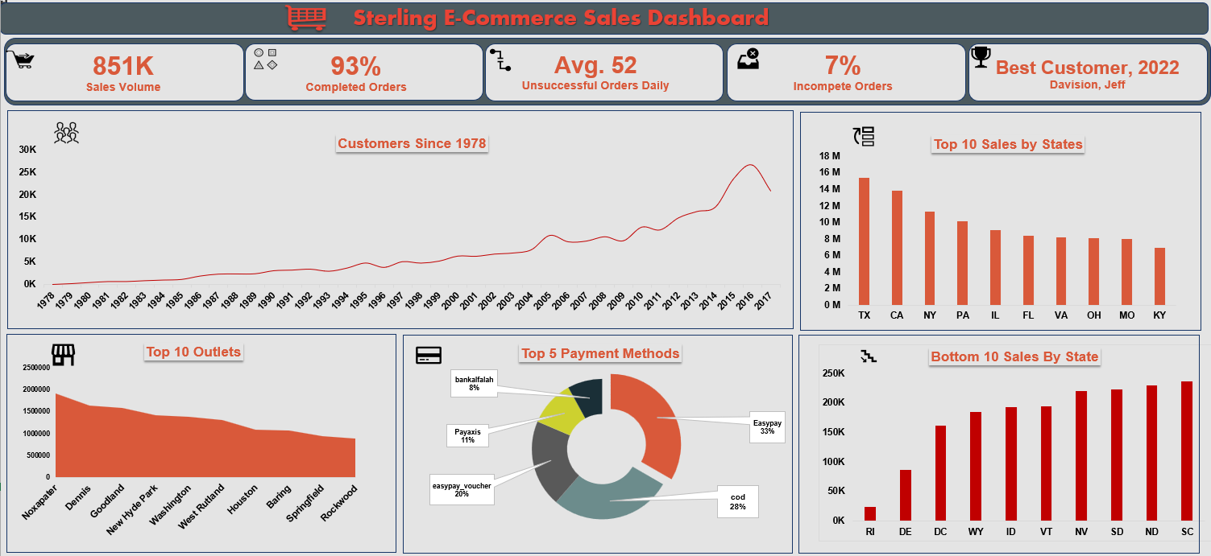

Slide 16
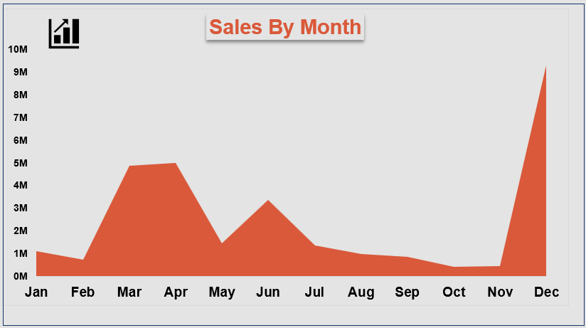

Slide 17
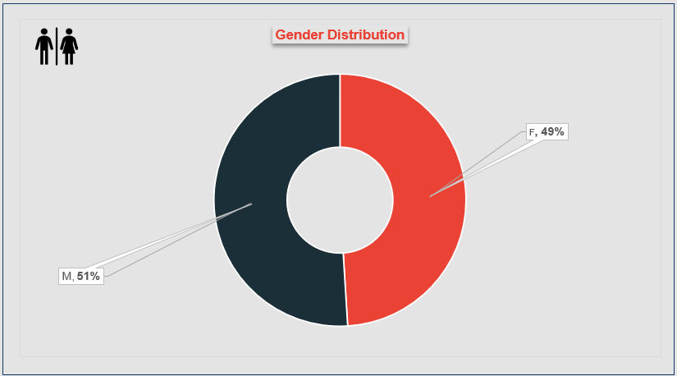

Slide 18
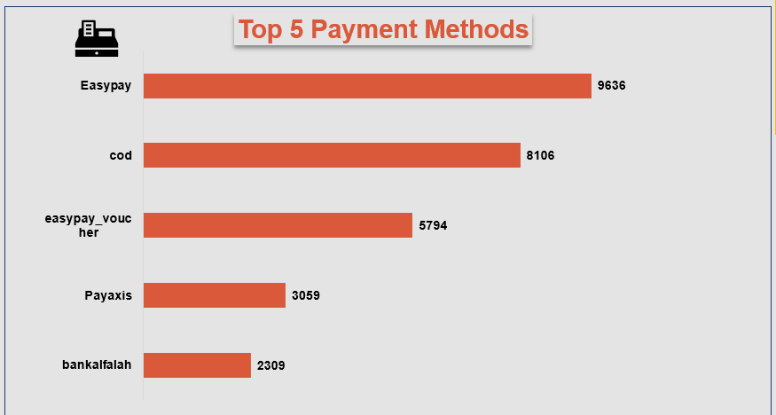

Slide 19
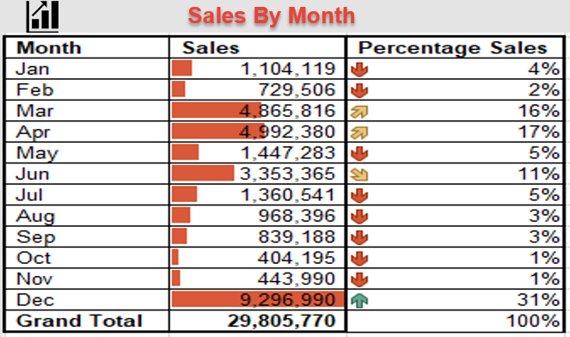

Slide 20
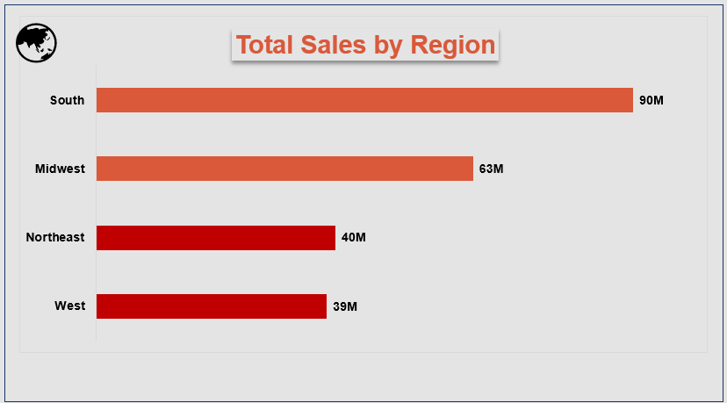

Slide 21
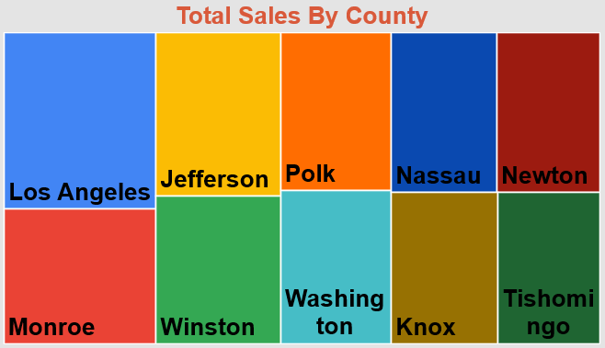

Slide 22
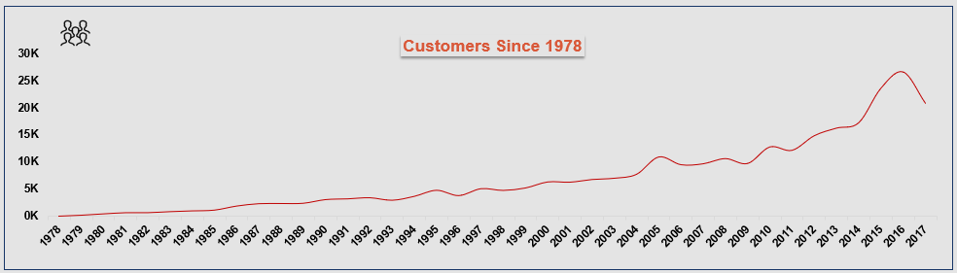

Slide 23
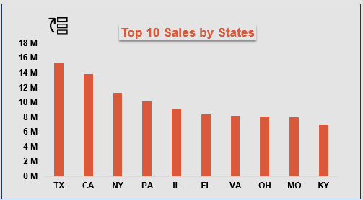

Slide 24
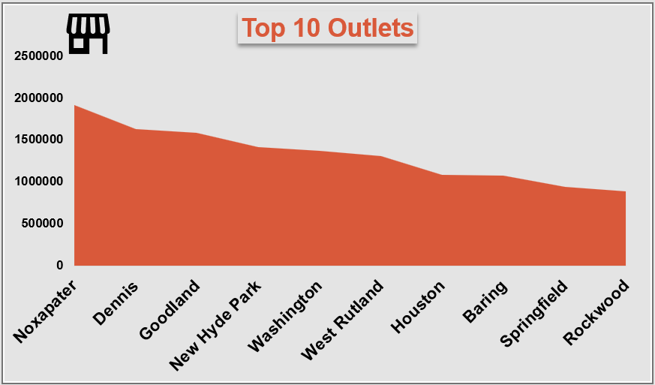

Slide 25
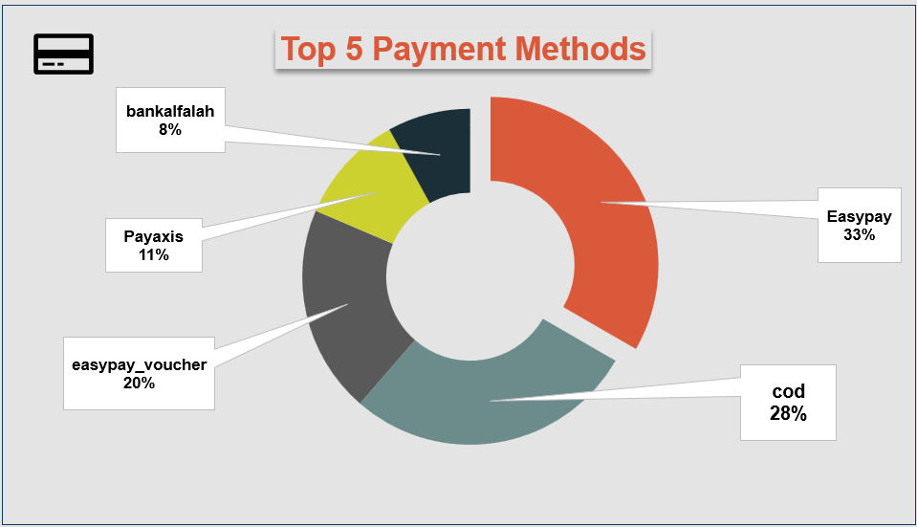

Slide 26
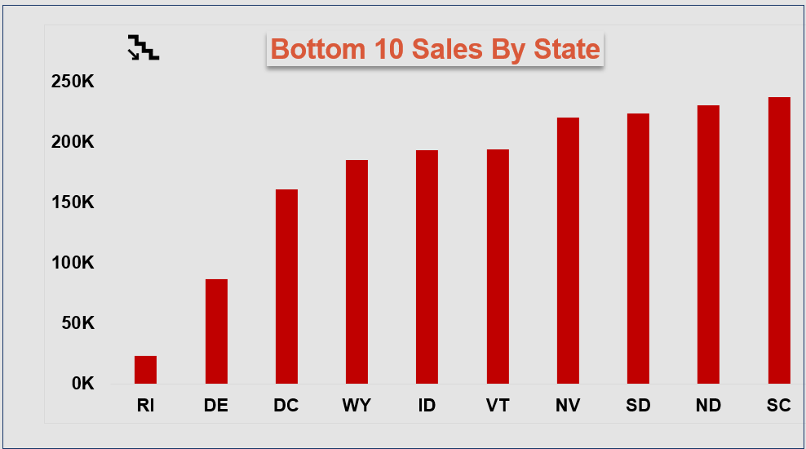

Slide 27
Some Vital Stats
Transactions | Count | Percentage
Total Count of orders | 283,083
Count of complete orders | 264,159 | 93%
Count of incomplete orders | 18,924 | 7%
Implication
 | Count | Per Day
Count of incomplete orders | 18,924/365 days | Approx. 52 incomplete orders per day.

Slide 28
Business Impact And Recommendations
1. Product Strategy:
- Promote Best-Selling Products.
- Diversify Product Offerings.
- Monitor Inventory Turnover.
If efforts yield no positive results, carry out a “Why-Why” Analysis or SWOT test.

Slide 29
2. Customer Engagement:
- Targeted Marketing
- Customer segmentation
- Enhance Customer Experience
- Initiate Loyalty Programs
- Leverage Social Media ads to reach targeted demographics.

Slide 30
3. Operational Efficiency:
- Optimize Fulfillment Process: Identify and eliminate bottlenecks.
- Payment Method Optimization: Analyze popular methods and optimize gateways.
- Customer Support: improving overall customer satisfaction by enhancing customer support services.
- Implement CRM tool to track and report progress.

Slide 31
4. Geographical Expansion:
Target High-Performing Regions: Allocate marketing budgets to regions.
- Localized Offerings: Consider offering region-specific products or promotions based on customers’ preferences in different areas.

Slide 32
5. Data-Driven Decision Making:
Continuous Monitoring: Implement a system for continuous monitoring of key metrics and customer feedback. Stay agile and adapt strategies based on changing customer behaviors and market trends.
- Predictive Analytics: Invest in predictive analytics models to forecast customer demand and trends, enabling proactive decision-making.

Slide 33
6. Customer Privacy and Security:
- Data Protection: Ensure strict adherence to data protection regulations to maintain customer trust. Regularly update security protocols to safeguard customer data. Protect customer PII.

Slide 34
7. Feedback Loop:
- Customer Feedback: Actively seek feedback from customers feedback to understand their preferences and pain points. Use this feedback to iterate on products, services, and customer experience.

Slide 35
Conclusion
Implementing the recommendations would boost customer satisfaction, sales, and operational efficiency for Sterling E Commerce, ensuring sustainable growth and a competitive edge in e-commerce. Continuous analysis and adaptation based on market changes and customer needs are essential. Adopting an Agile approach company-wide would yield significant benefits.

Slide 36


Slide 37
Q & A

